Slide 1


Ahmed Shahriar Sakib
09.07.2021

Slide 2

Outline
Executive Summary
Introduction
Methodology
Results
Conclusion
Appendix

Slide 3
Executive Summary
Summary of methodologies
In this project, the Falcon9 Launch data was collected via SpaceX API and Falcon 9 launch wiki page by web scraping using BeautifulSoup4, and later on stored in a csv for further analysis. Before performing any exploratory and visual analysis of the data, it was cleaned by getting rid of unwanted features, replacing the missing values, creating a label for the predictive analysis and finally, converting all the categorical features into numerical forms. After that, performed several visual analytics to get more insights about features and their relations with launching outcome. Finally, performed a predictive analysis to train and evaluate a best model that can give answer via prediction to our question whether a landing would be successful or not.
Summary of all results
Exploratory and Visual Analysis:
Payload greater than 7500 kg had a higher chance of successful landing
Among 11 orbit types , ES-L1, GEO, HEO, SSO were 100% successful with less than 6000 kg payload

Slide 4
Executive Summary [Continued]
Exploratory and Visual Analysis:
From 2010 to 2019, 61 missions had successful landing whereas 10 missions had failure landing, leading a success rate of 67.78%
Among the four Launch sites “KSC LC-39A” had the highest success rate (41.7%) whereas, “VAFB SLC-4E” had the lowest success rate (12.5%)
In 0-10000 kg payload range “FT” booster version has the largest success rate
Launch Site Proximity Analysis:
SpaceX has 4 launch sites, one is near California, the other three is near Florida and South Texas.
All the sites are in near proximity to ocean
All the sites are bit far away from the city
Predictive Analysis:
Logistic Regression and SVM performed well in comparison with other models, with the highest accuracy of 83.3%

Slide 5
Introduction
Introduction
Project background and context
SpaceX is a company that aims to make commercial space travel more affordable for everyone. This company can launch rockets in a relatively inexpensive manner because, it can reuse the first stage of the rocket Falcon9, which is the first orbital class rocket capable of reflight
In this project, we are working for Space Y, which is going to compete with SpaceX. Our goal is to find the price of each launch. And this price mainly depends on the successful landing of the first stage
Problems we want to find answers
Will SpaceX reuse the first stage?
Will SpaceX attempt to land a rocket or not? i.e., will the first stage land successfully?
5

Slide 6


Slide 7
Methodology
Executive Summary
Data collection methodology:
Data was collected via SpaceX API and web scraping using python “bs4” package.
Performed data wrangling
Data was processed using python “pandas”, “numpy” packages.
Performed exploratory data analysis (EDA) using visualization and SQL
Performed interactive visual analytics using Folium and Plotly Dash
Performed predictive analysis using classification models
Classification models were built, tuned, evaluated using python “sklearn”, “pandas”, and, “matplotlib” packages

Slide 8
Data Collection
Data were collected in two separate processes – using SpaceX API and web scraping the SpaceX wiki page. Scraped datasets were later preprocessed and stored in separate CSV files.
Request rocket launch data to SpaceX URL using SpaceX-API
Parse the data from html text
Request More data using Launch IDs
Start
Construct “Pandas” DataFrames with Scraped Data
Request the Falcon9 Launch Wiki page using ‘requests’ module
Request rocket launch data
Parse the table from html text using “bs4”

Slide 9
Data Collection – SpaceX API
GitHub URL of the completed SpaceX API calls notebook
Define Variables and Auxiliary Functions
SpaceX-API
Request launch data to SpaceX URL
Parse the data from html text
Request More data using Launch IDs
Preprocess and Construct the Data
Store the Data in CSV File

Slide 10
Data Collection - Scraping
GitHub URL of the completed web scraping notebook
Request the Falcon9 Launch Wiki page using ‘requests’ module
Request rocket launch data
Parse the table data from html text using bs4
Create a “pandas” data frame from table data
Construct the Data and Store it in CSV format

Slide 11
Data Wrangling
Summary - The Falcon 1 launches data was filtered out the from scraped dataset. The null values inside of PayLoadMass were replaced by its mean value. A Landing Outcome label (“landing_class”) created from Outcome column. All categorical columns were converted using “One Hot Encode” and numerical columns were converted to float datatype.
GitHub URL of completed data wrangling related notebook-1 , notebook-2, notebook-3
Construct a “Pandas” DataFrame with Scraped Data
Dealing With Missing Values
One Hot Encoding to Categorical Columns
Filter the DataFrame to Only Falcon 9 launches
Create A Landing Outcome Label From Outcome Column
Cast All Numeric Columns to “float64”
Construct the Final DataFrame and dump in CSV file

Slide 12
EDA with Data Visualization
For Explorative Data Analysis, following charts were used:
CatPlot :
FlightNumber vs LaunchSite : To visualize the relationship between Flight Number and Launch Site
Payload vs Launch Site : To visualize the relationship between Payload and Launch Site
FlightNumber vs Orbit type : To visualize the relationship between Flight Number and Orbit type
Payload vs Orbit type : To visualize the relationship between Payload and Orbit type

Slide 13
EDA with Data Visualization [Continued]
Bar Chart
Orbit vs Success Rate : To visualize the relationship between success rate of each orbit type
Line chart
Year vs Class : To visualize the launch success yearly trend
GitHub URL of the completed EDA with data visualization notebook

Slide 14
EDA with SQL
SQL queries performed :
To display the names of the unique launch sites in the space mission
To display 5 records where launch sites begin with the string 'CCA’
To display the total payload mass carried by boosters launched by NASA (CRS)
To display average payload mass carried by booster version “F9 v1.1”
To list the date when the first successful landing outcome in ground pad was achieved
To list the names of the boosters which have success in drone ship and have payload mass greater than 4000 but less than 6000

Slide 15
EDA with SQL [Continued]
SQL queries performed [Continued] :
To list the total number of successful and failure mission outcomes
To list the names of the booster versions which have carried the maximum payload mass. Use a subquery
To list the failed landing outcomes in drone ship, their booster versions, and launch site names for in year 2015
To rank the count of landing outcomes (such as Failure (drone ship) or Success (ground pad)) between the date 2010-06-04 and 2017-03-20, in descending order
GitHub URL of the completed EDA with SQL notebook

Slide 16
Build an Interactive Map with Folium
Map objects which are created and added to the folium map are given below :
Markers : Added to mark a specific area with a text label on a specific coordinate
Circles : Added to highlight circle areas with a text label on a specific coordinate
MarkerCluster : Marker clusters were used to simplify the containing many markers having the same coordinates.
MousePosition : Used to get coordinate for a mouse over a point on the map (proximities). It helps to find the coordinates easily of any points of interests while exploring the map
PolyLine : It draws polyline overlays on a map. It was used to denote the distance between a launch site and its proximities. (such as Railway station, city etc.)
Jupyter Notebook link to view the Lab Codes with Folium Map
GitHub URL of the completed interactive map with Folium map

Slide 17
Build a Dashboard with Plotly Dash
Plots/graphs and interactions which are added to the dashboard -
Drop-down Input Component : To select different launch sites
Pie-chart : To visualize total success launches ratio by site
Range Slider : To select range of payload mass (kg)
Scatter Plot : To visualize the correlation between payload and success launch for all sites
GitHub URL of the completed Plotly Dash lab

Slide 18
Predictive Analysis (Classification)
The Following chart illustrates the whole predictive analysis workflow: from loading the data to selecting best model for classification
GitHub URL of the completed predictive analysis lab
Load the data
Create Model and GridSearchCV objects
Calculate Accuracy for Different Models
Features Standardization
Initiate Different GridSearachCV objects with models’ hyperparameters
Plot Confusion Matrix for Different Models
Split the Data Into 80:20 Ratio
Tune Models’ Hyperparameters
Select Best Performing Model

Slide 19
Results
Exploratory data analysis results -
Payload greater than 7500 kg had a higher chance of successful landing
Among 11 orbit types , ES-L1, GEO, HEO, SSO were 100% successful with less than 6000 kg payload
From 2010 to 2019, 61 missions had successful landing whereas 10 missions had failure landing, leading a success rate of 67.78%
Among the four Launch sites “KSC LC-39A” had the highest success rate (41.7%) whereas, “VAFB SLC-4E” had the lowest success rate (12.5%)
In 0-10000 kg payload range “FT” booster version has the largest success rate

Slide 20
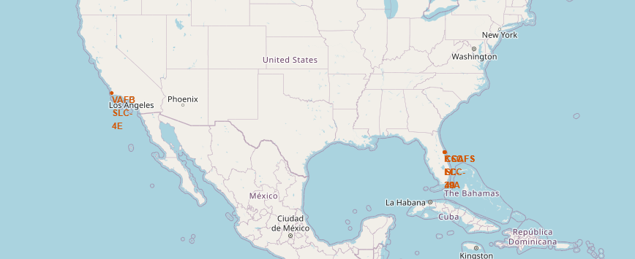
Results [Continued]
Interactive analytics Folium Lab

Slide 21
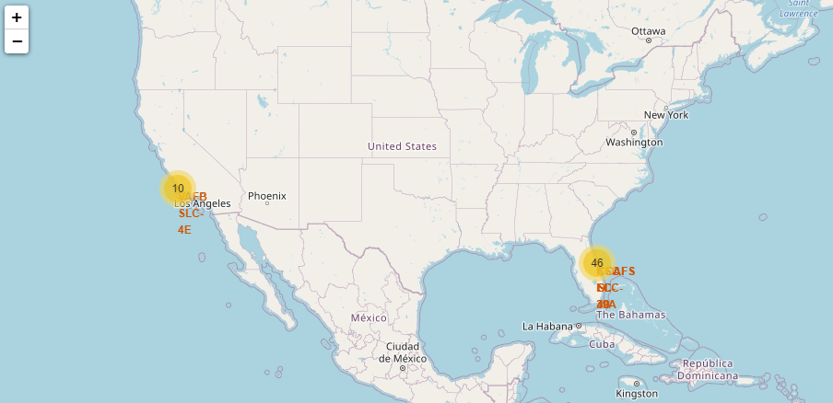
Results [Continued]
Interactive analytics Folium Lab

Slide 22
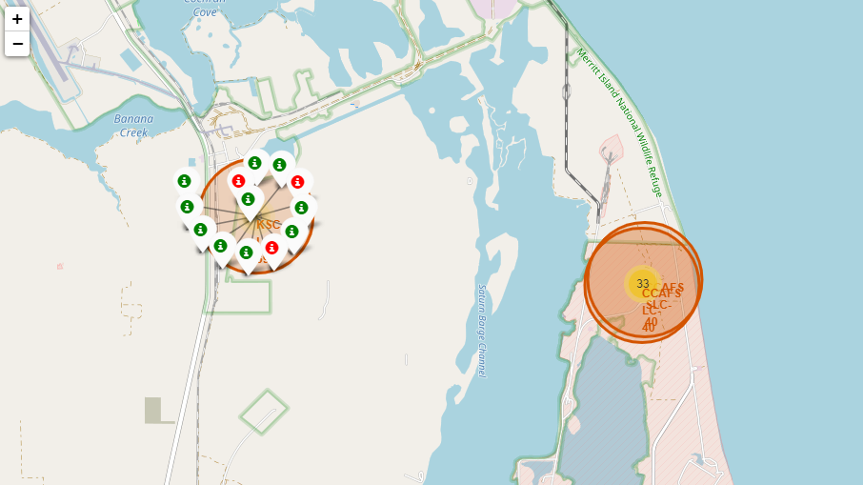
Results [Continued]
Interactive analytics Folium Lab

Slide 23
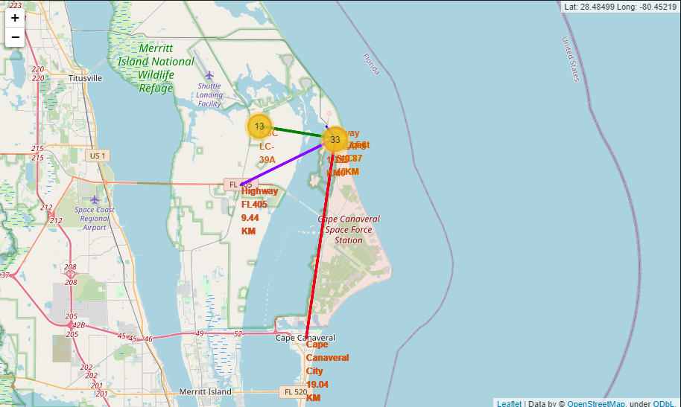
Results [Continued]
Interactive analytics Folium Lab

Slide 24
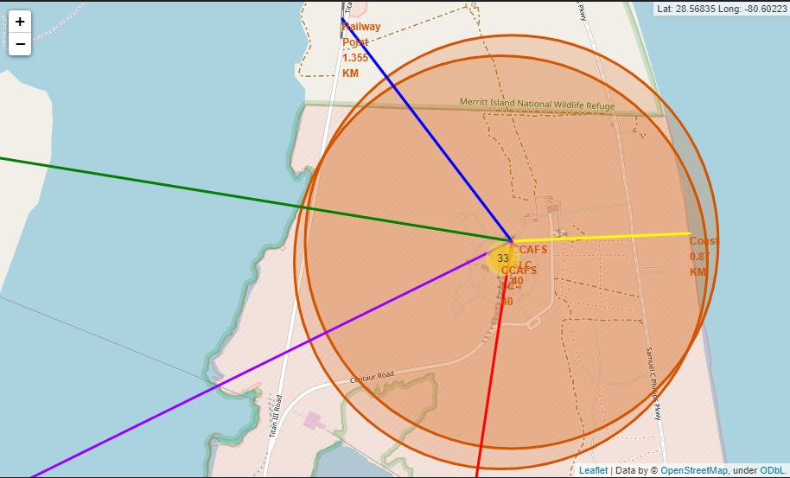
Results [Continued]
Interactive analytics Folium Lab

Slide 25
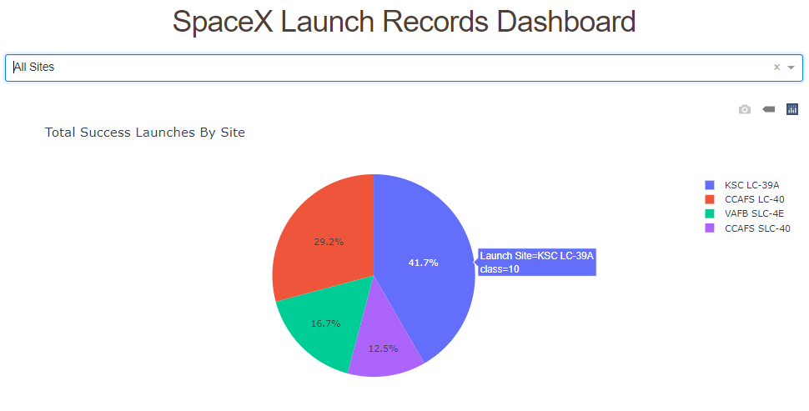
Results [Continued]
Interactive analytics dashboard

Slide 26
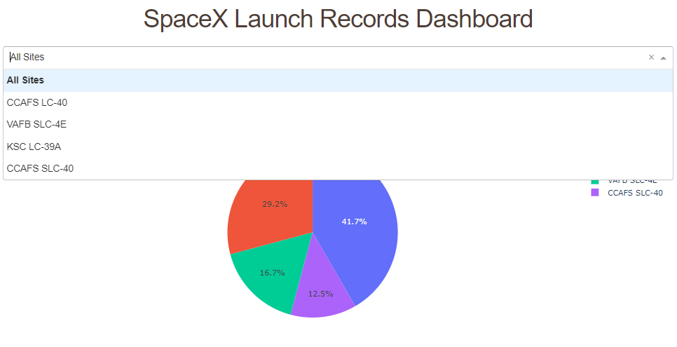
Results [Continued]
Interactive analytics dashboard

Slide 27
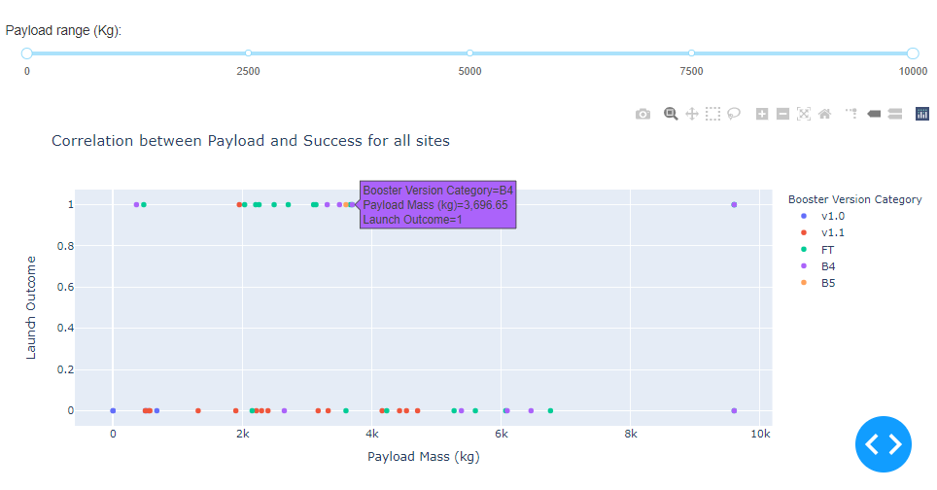
Results [Continued]
Interactive analytics dashboard

Slide 28
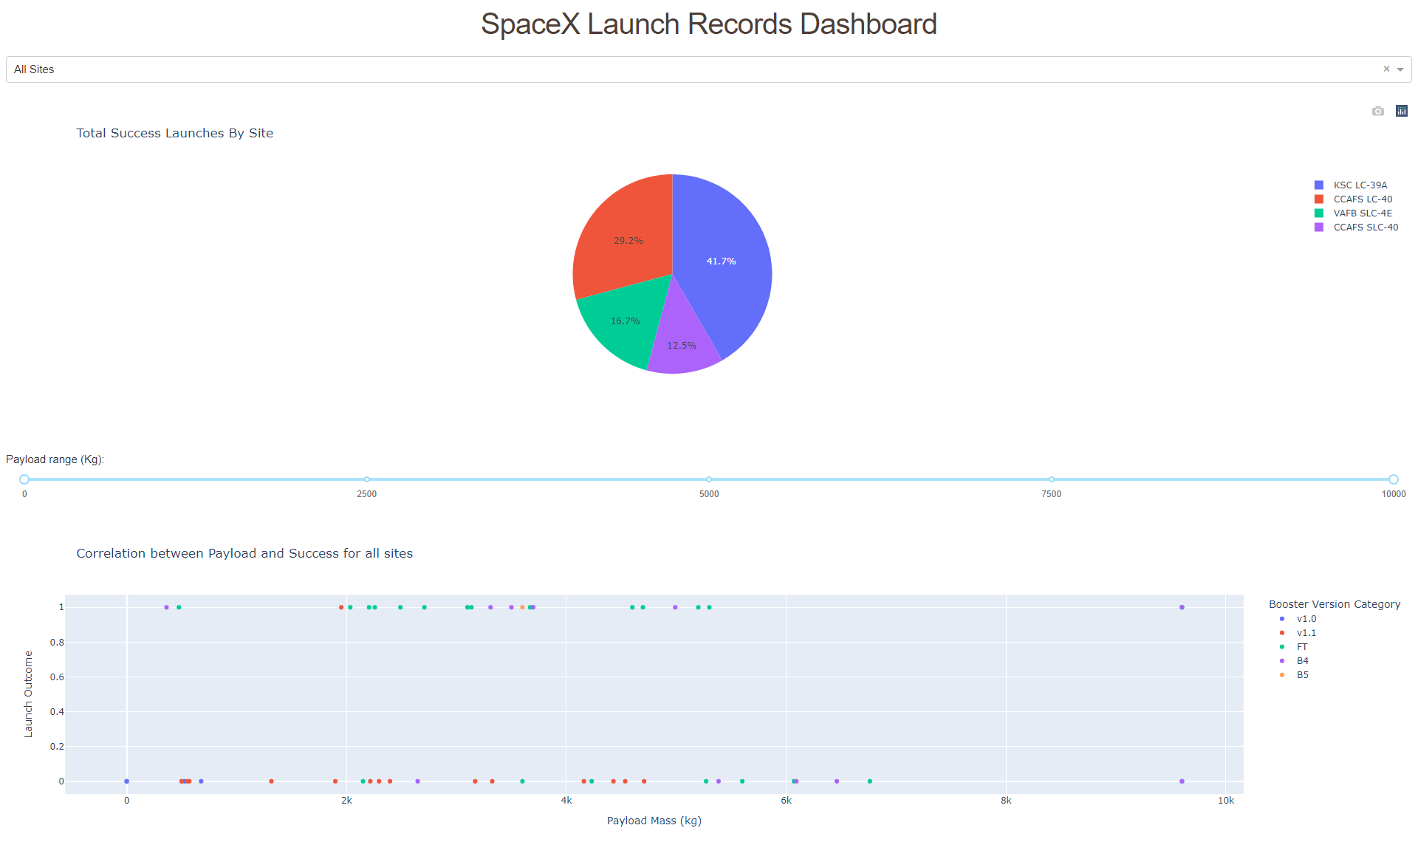
Results [Continued]
Interactive analytics dashboard

Slide 29
Results [Continued]
Predictive analysis results
Performed a predictive analysis on the dataset using Logistic Regression, SVM, Decision Tree and KNN Classifier
Logistic Regression and SVM performed well in comparison with other models, with the highest accuracy of 83.3%

Slide 30


Slide 31
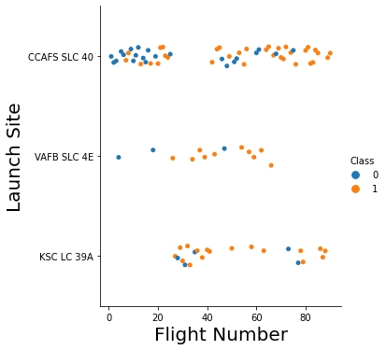
Flight Number vs. Launch Site
Success rate was gradually increasing for every launch site
After flight count reached 40, success rate increased dramatically

Slide 32
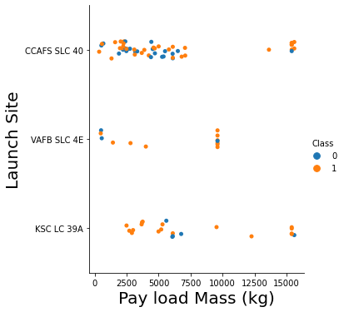
Payload vs. Launch Site
Payload greater than 7500 kg had a higher chance of successful landing (in all cases)
KSC LC 39A had the highest success rate among the 4 launch sites

Slide 33
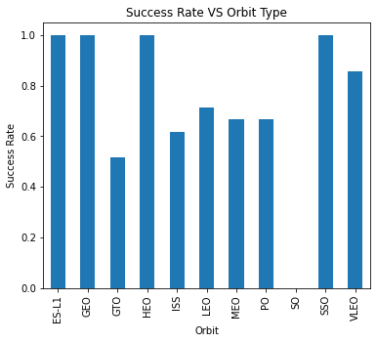
Success Rate vs. Orbit Type
“SO” orbit had no success
Among 11 orbit types , 4 types were 100% successful(ES-L1, GEO, HEO, SSO)
“GTO” had approximately 50% success rate whereas the rest of the orbit types had more than 50% success rate

Slide 34
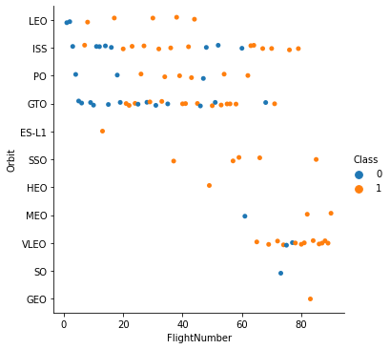
Flight Number vs. Orbit Type
LEO , ISS, PO ,GTO had more flight counts than other orbit types
SO,GEO,HEO orbit type had only 1 flight which was a failure, success and success respectively
ES-L1, SSO, GEO, HEO had 100% success landing in terms of flights

Slide 35
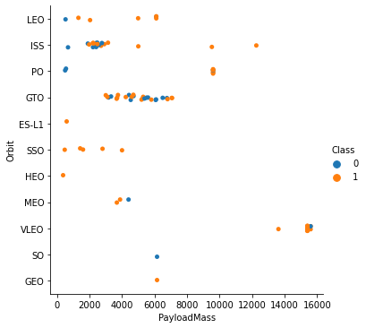
Payload vs. Orbit Type
Only ISS, PO and VLEO orbits carried more than 8000 kg payload
ES-L1, SSO, HEO,GEO had less than 6000 kg payload in their orbit with 100% success

Slide 36
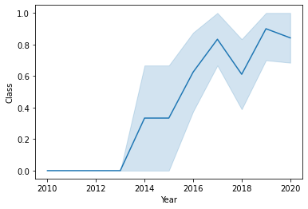
Launch Success Yearly Trend
Before 2013, there was no success
After 2013 success rate increased dramatically
Launch success peaked in 2019

Slide 37
All Launch Site Names
There are total of 4 launch sites, the list is given below -
Launch Site
CCAFS LC-40
CCAFS SLC-40
KSC LC-39A
VAFB SLC-4E

Slide 38
Launch Site Names Begin with 'CCA'
The below list represents 5 records where launch sites begin with `CCA`, all of them refers to the same launch site
Launch Site
CCAFS LC-40
CCAFS LC-40
CCAFS LC-40
CCAFS LC-40
CCAFS LC-40

Slide 39
Total Payload Mass
Total payload carried by boosters from NASA
Total Payload Mass
107010

Slide 40
Average Payload Mass by F9 v1.1
The average payload mass carried by booster version F9 v1.1. It is roughly 3000 kg
Avg Payload Mass (F9 v1.1)
2928.400000

Slide 41
First Successful Ground Landing Date
The date of the first successful landing outcome on the ground pad. It is the end of 2015
Date
2015-12-22

Slide 42
Successful Drone Ship Landing with Payload between 4000 and 6000
The below list represents the names of boosters which have successfully landed on drone ship and had payload mass greater than 4000 but less than 6000 -
Booster Version
F9 FT B1022
F9 FT B1026
F9 FT B1021.2
F9 FT B1031.2

Slide 43
Total Number of Successful and Failure Mission Outcomes
The total number of successful and failure mission outcome. The successful outcomes is 6 times of the failure outcomes
successful_outcomes | failure_outcomes
61 | 10

Slide 44
Boosters Carried Maximum Payload
The below list represents the names of the booster which have carried the maximum payload mass. It’s a total of 12
Booster Version
F9 B5 B1048.4 | F9 B5 B1049.5
F9 B5 B1049.4 | F9 B5 B1060.2
F9 B5 B1051.3 | F9 B5 B1058.3
F9 B5 B1056.4 | F9 B5 B1051.6
F9 B5 B1048.5 | F9 B5 B1060.3
F9 B5 B1051.4 | F9 B5 B1049.7

Slide 45
2015 Launch Records
The below list represents the failed landing outcomes in drone ship, their booster versions, and launch site names for in year 2015. It happened in the same launch site
Landing__Outcome | Booster_Version | Launch_Site
Failure (drone ship) | F9 v1.1 B1012 | CCAFS LC-40
Failure (drone ship) | F9 v1.1 B1015 | CCAFS LC-40

Slide 46
Rank Landing Outcomes Between 2010-06-04 and 2017-03-20
The below list represents the ranking of the count of landing outcomes (such as Failure (drone ship) or Success (ground pad)) between the date 2010-06-04 and 2017-03-20, in descending order
Landing Outcome | Count
No attempt | 10
Failure (drone ship) | 5
Success (drone ship) | 5
Controlled (ocean) | 3
Success (ground pad) | 3
Failure (parachute) | 2
Uncontrolled (ocean) | 2
Precluded (drone ship) | 1

Slide 47


Slide 48
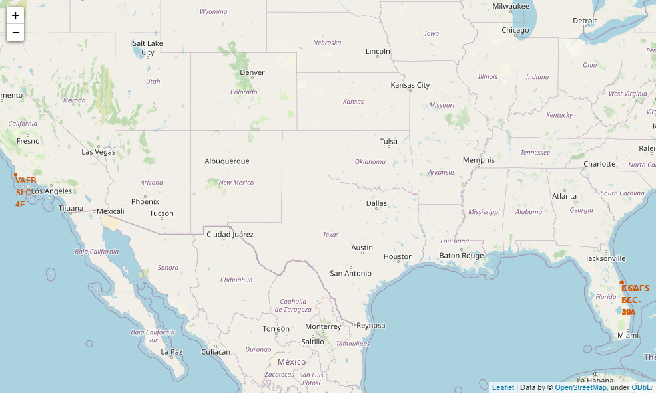
All Launch Sites Of SpaceX On The Map
SpaceX has 4 launch facilities, one is near California, the other three facilities are near Florida and South Texas. All facilities are near the ocean

Slide 49
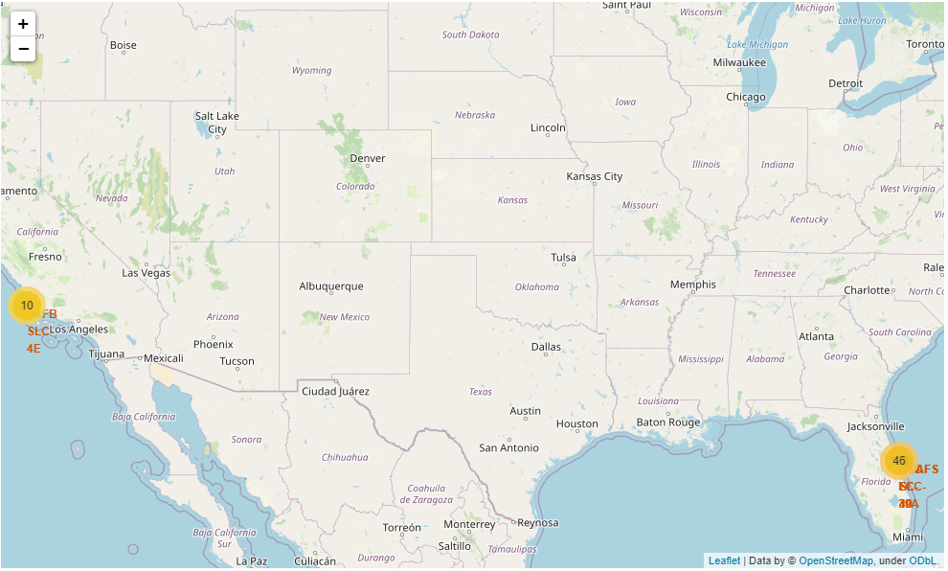
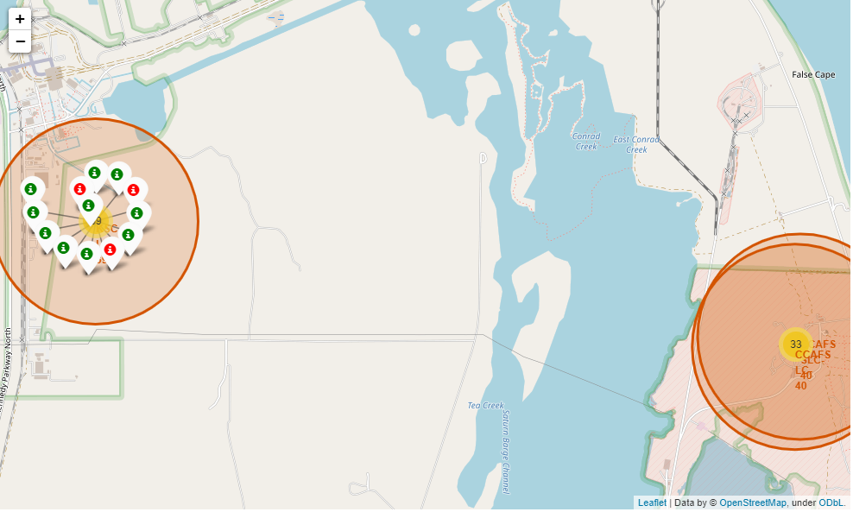
Success/Failed Launches For Each Site On The Map
Marker clusters is used to simplify the map containing many markers having the same coordinate (check 3 locations near Florida). Successful launches are marked using a green marker and failed launches are marked using a red marker

Slide 50
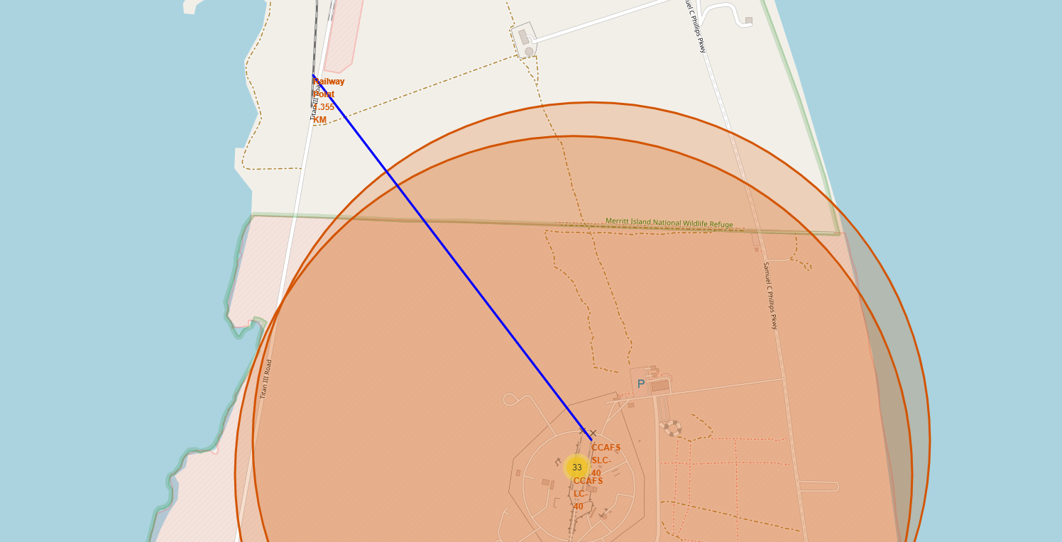
Distance Between A Launch Site To Its Proximities
A blue distance line denotes the distance between a launch site ( CCAFS SLC-40 ) to a nearby railway station, (denoted as “Railway Point 1.355 KM”)

Slide 51


Slide 52
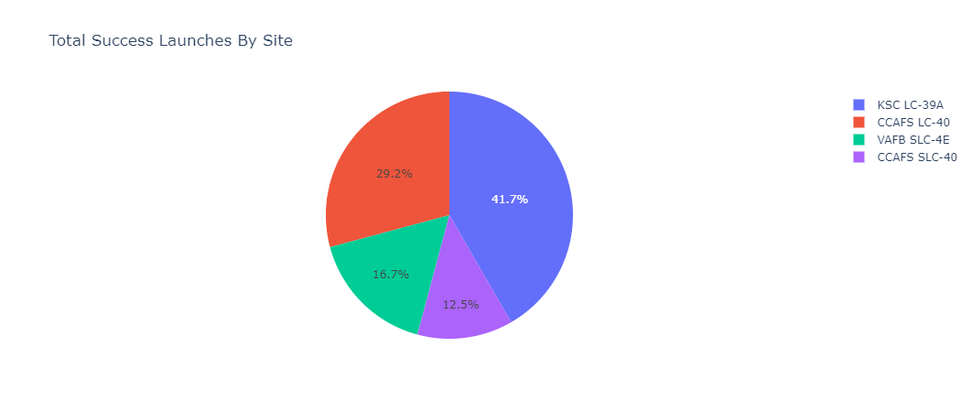
Total Success Launches By Site
Below is the screenshot of launch success count for all sites, in a pie-chart
“KSC LC-39A” has the highest success ratio whereas “VAFB SLC-4E” had the lowest success ratio among all four launch sites

Slide 53
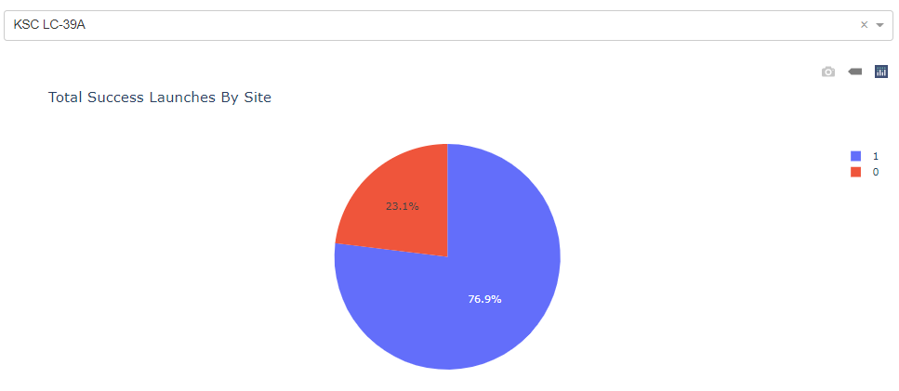
Launch Site With Highest Launch Success Ratio
Below is the screenshot of the pie-chart for the launch site with the highest launch success ratio – “KSC LC-39A”
It has 77% of success ratio

Slide 54
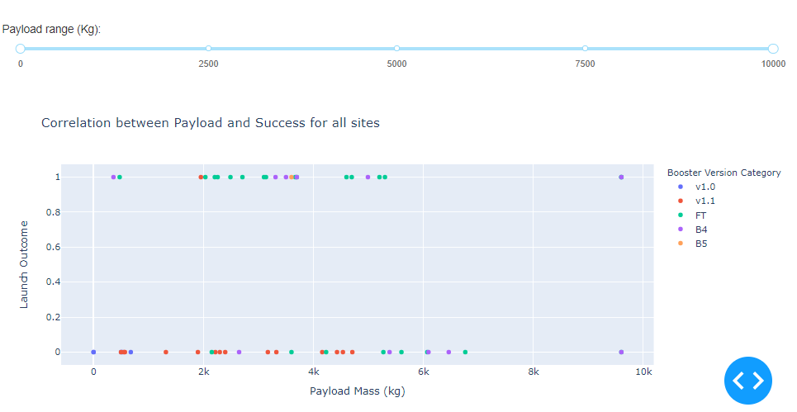
Payload vs. Launch Outcome
Below are the screenshot of Payload vs. Launch Outcome scatter plot for all sites, with different payload selected in the range slider
In 0-10000 kg payload range “FT” booster version has the largest success rate

Slide 55
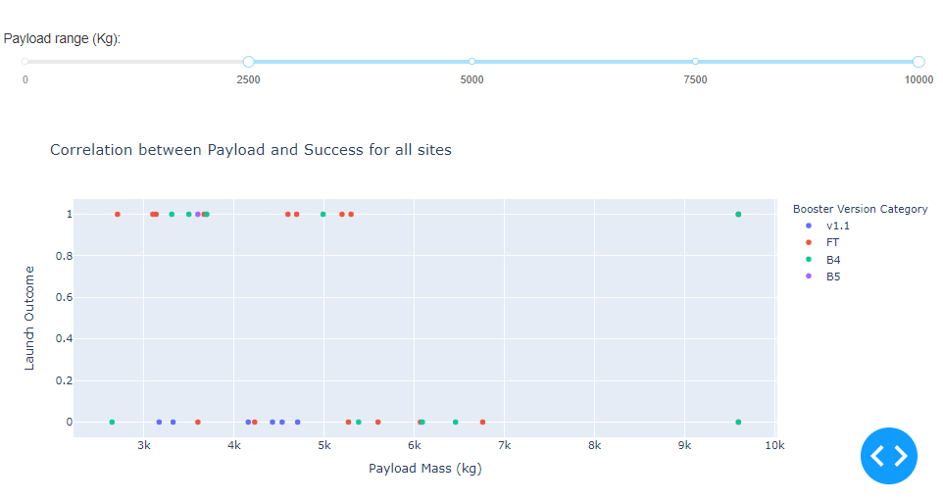
Payload vs. Launch Outcome [Continued]
Payload vs. Launch Outcome between 2500 kg and 10000 kg
In this range “FT” booster version has the largest success rate

Slide 56
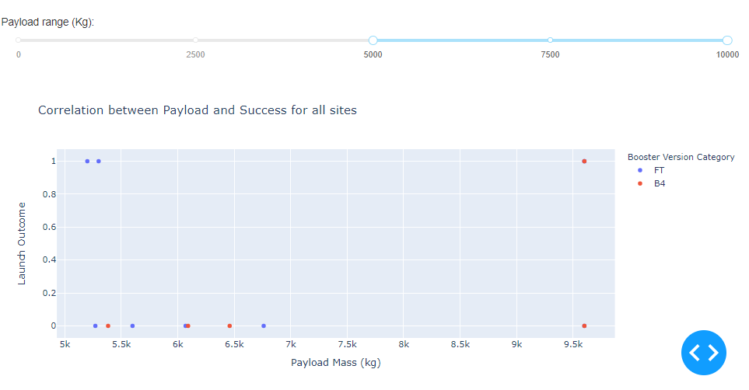
Payload vs. Launch Outcome [Continued]
Payload vs. Launch Outcome between 5000 kg and 10000 kg
In this range “FT” booster version has the largest success rate whereas “B4” booster version has no success

Slide 57

Payload vs. Launch Outcome [Continued]
Payload vs. Launch Outcome between 7500 kg and 10000 kg
In this range only “B4” booster version is used and has equal success / failure rate

Slide 58


Slide 59
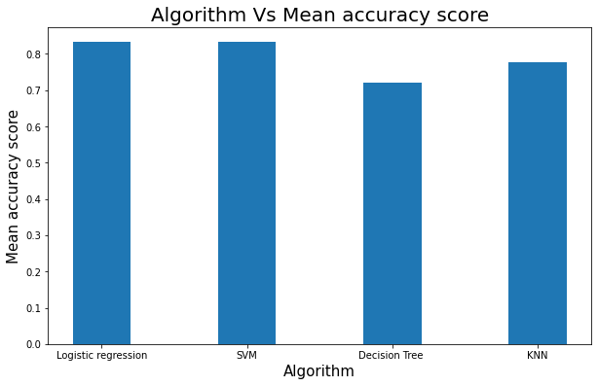
Classification Accuracy
Logistic Regression and SVM has the highest accuracy which is approximately 0.83
Decision Tree Classifier has the lowest accuracy (0.72) among all four models

Slide 60
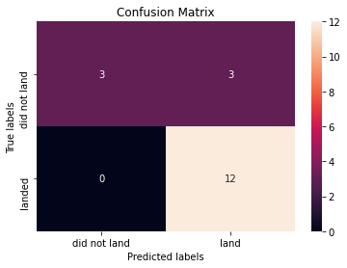
Confusion Matrix
Below is the confusion matrix of the best performing model (Logistic Regression and SVM – both generates the same result)
It has True Positive value of 12 and False Negative of 0. It means this model correctly identified 12 instances which was originally belong to class 1(successful landing), conversely it predicted correctly only 50% (3 out of 6) of the class 0 (landing failure)

Slide 61
Conclusions
The project explored the SpaceX data and built a classifier on whether a rocket launch outcome (landing) would be successful or not
More data is needed for better prediction
Different algorithms should be explored to generate a better accurate classifier (Gradient boosting, Neural Network etc.)
An end-to-end pipeline should be built for classification model that automates most of its process.

Slide 62
Appendix
Function to report about missing values from a pandas dataframe
Code snippet on automated hyperparameter tuning
Folium Map on SpaceX successful or failed launches for each launch site
Folium Map on The distances between a launch site to its proximities

Slide 63


